Slide 1

Physics-based Machining of Aerospace Materials
Dr. Suhas Joshi
Professor, Department of Mechanical Engineering
Indian Institute of Technology Bombay, Mumbai – 400076
Email: ssjoshi@iitb.ac.in

Slide 2
Plan of Presentation
Introduction
Titanium alloys, their properties and machining difficulties
Theme and Methodology of the work
Chip segment morphology
Mechanics of a chip segment formation
Chip and shear band microstructure
Correlation between machinability and microstructure
Summary and conclusions

Slide 3

Physics-based Machining
Physics-based Machining refers to understanding -
several microscopic phenomena that occur during machining,
the effect of these phenomena on a chip segment and grain deformation,
the effect on physical and mechanical properties of resulting surfaces,
the consequent machinability or quality of machined surface.

Slide 4
Physics-based Machining
Tool – work interface
On Tool
Intense Friction and wear, heat generation
On Work surface
Material separation, severe deformation, machining affected zone.
Face
Tool
Chip
Un-deformed
chip thickness
Flank surface
Machined surface
Work
Shear plane/zone
Largest energy consumer
Strain: 2-8
Temperature: 200 – 1100ºC
Strain rate: 10³ - 10⁶ s⁻¹
Chip-tool interface
Intense 2-body / 3-body Friction
Crater wear
Determines position of shear zone

Slide 5
High strength-to-weight ratio (Light weight)
Maintains strength at higher temperature of 440 °C
Good corrosion resistance
Compatibility with composites
Inertness to human body
Titanium Alloys Properties

Slide 6
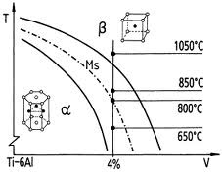
Properties of Titanium alloys
α+β
Alpha alloy
Alpha + Beta alloy
Beta rich (Alpha + Beta alloy)
Alpha | Alpha + Beta | Beta rich alloy
Medium strength Not heat treatable Good creep and corrosion resistance | Medium to high strength Heat treatable and formable | High strength, low ductility Heat and weld treatable Good formability

Slide 7
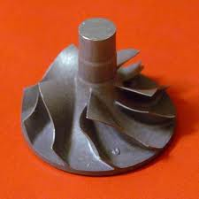
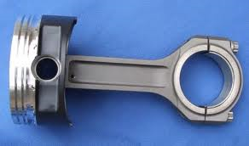
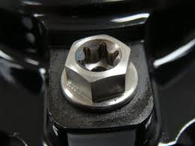
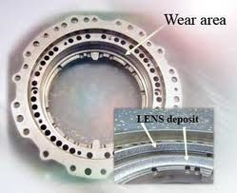
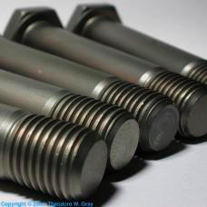

Applications of Titanium Alloys
Impeller
Piston
Ultra light weight bolt
Bearing housing
of gas turbine
Fasteners
Airframe structure

Slide 8
Properties causing Difficulties in Machining
Low Thermal conductivity
High Reactivity
High strength at high temp.
Segmented chips
Low elastic modulus
High machining temperature
High tool wear
High cutting forces
Chemical wear
Ti alloy 15 W/m °C, Steel 43 W/m °C
Tool melting
Adhesion
Tool breakage
Chatter
Poor surface finish
Ti alloy 110 GPa, Steel 210 GPa
Shear band formation
Cyclic load on the tools

Slide 9
Theme of Physics-based Machining
Chip segment deformation
Chip segment Morphology
Physics-based Machining
Shear band spacing and thickness
Correlation between microstructural deformation and Machinability
Grain transportation and deformation
Grain deformation in machined surfaces

Slide 10
Applications of Titanium Alloys
Impeller
Piston
Ultra light weight bolt
metallurgyfordummies.com
www.topcast.it
www.mvagusta.net
Bearing housing
of gas turbine
Fasteners
Airframe structure
www.mvagusta.net
www.mvagusta.net
www.airbus.com

Slide 11
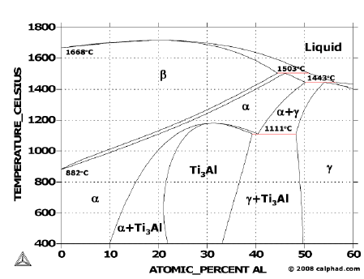
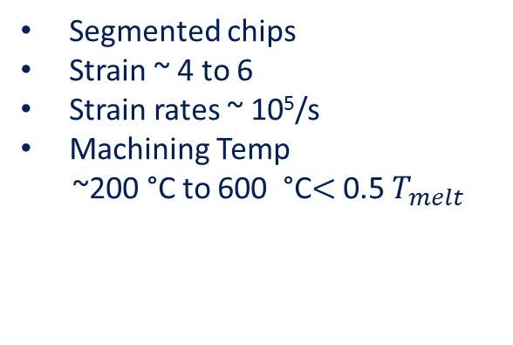
Orthogonal Machining of Ti64 alloy
Deformation zones in machining
Characteristics of machining
Segmented chips
Strain ~ 4 to 6
Strain rates ~ 10⁵/s
Machining Temp
~200 °C to 600 °C$<$ 0.5 $T_{melt}$
Chip
Shear
bands
Tool
Phase diagram Ti-Al
Deformation of grains
Shear
zone
Machining
affected
zone
Work
piece
Microstructural changes in
  Primary deformation or shear zone
  Machining affected zone
http://www.calphad.com

Slide 12
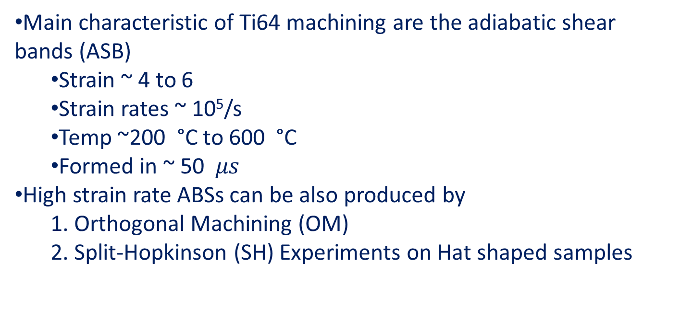
Distinguishing feature of Ti64 machining
Main characteristic of Ti64 machining are the adiabatic shear bands (ASB)
  Strain ~ 4 to 6
  Strain rates ~ 10⁵/s
  Temp ~200 °C to 600 °C
  Formed in ~ 50 $μs$
High strain rate ABSs can be also produced by
  1. Orthogonal Machining (OM)
  2. Split-Hopkinson (SH) Experiments on Hat shaped samples
Notes:
Possible micro-mechanism:
Shear due to
- dislocation slip
- twinning
- grain boundary sliding
Softening due to:
- high temperature
- strain softening (inverse strain hardening)
- texture evolution
- dynamic recovery
- dynamic recrystallization

Slide 13
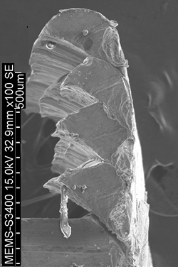
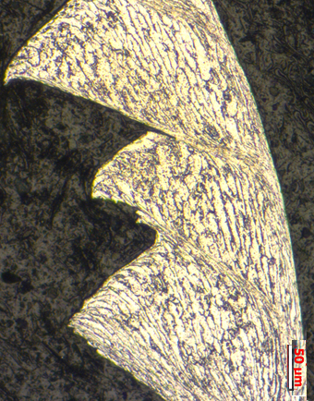
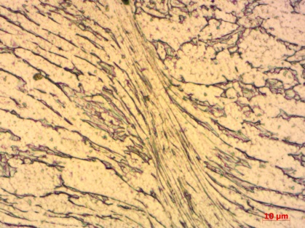
Issues in machining titanium alloys (microstructural perspective)
SEM image of chip
Optical image of chip
Shear band
Segmented
chip
shear
band
shear
band
Fracture
shear
band
a
Work
Formation of shear band causes
Fluctuation in cutting forces
Non uniform material deformation

Slide 14




Plan of Research
Mist jet
Shear band thickness
Thermally
enhanced
LN₂
Spacing between shear band
Room
Temp.
Machining
environment
Physics of
deformation
in machining
Grain size
α-alloy
α+β alloy
Compositional
variation
Grain deformation
β-rich alloy
Segment shape
Processing parameters
Speed
Segment dimensions
Feed
Input
Output
microstructure machinability
linkage

Slide 15






Experimental set up
Plain strain condition
Four jaw chuck
Quick stop chip freezing device
Thin pipe of large dia.
1 mm
$$A$$
Fulcrum
Quick withdrawal of tool
Workpiece
$∅$ 93mm
Mounted sample
Insert
Epoxy mould
Cutting edge
larger than pipe
thickness
Tool
Frozen chip root
Feed
Shear
bands
$$B_{1}$$
$$C$$
$$B_{2}$$
Tool holder
Shear
pin
Work piece
c. Quick withdrawal
of tool
Machining affected zone

Slide 16
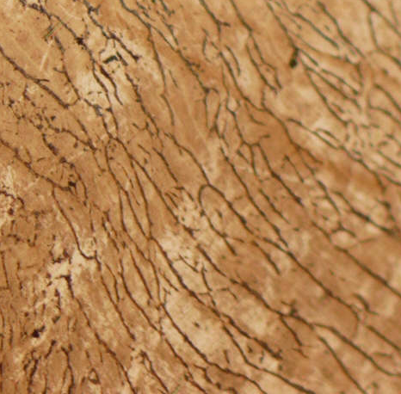
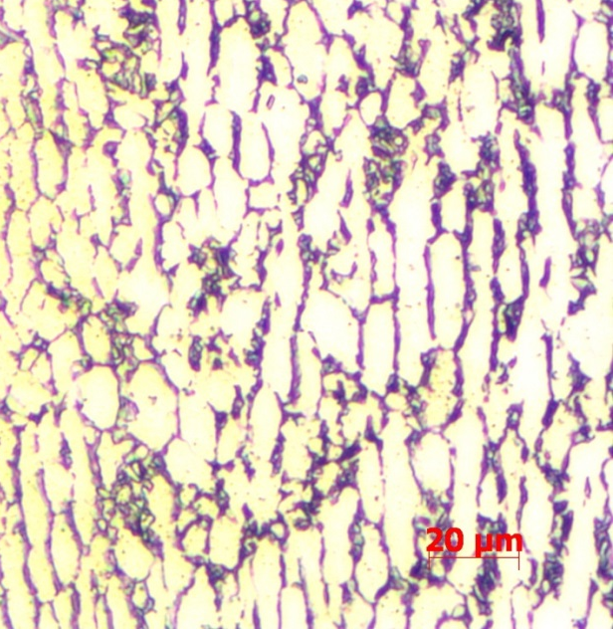
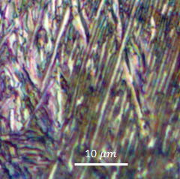





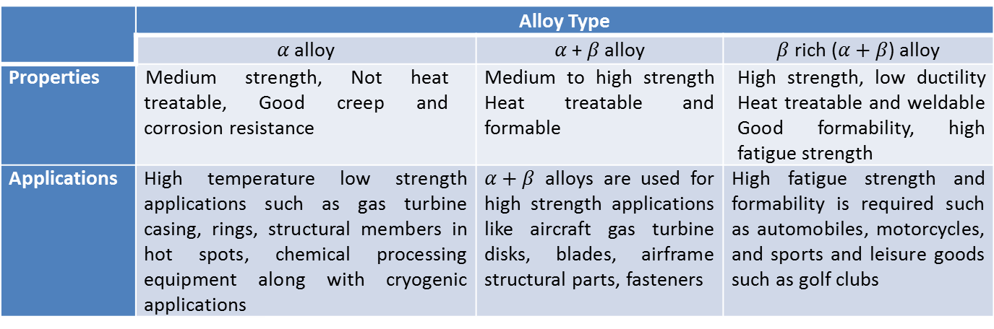
Properties of three titanium alloys
α alloy
α+β alloy
β rich alloy
$$lamellar structure$$
$$with alternate$$
$$layer of α phase\left(white colour\right)$$
$$and$$
$$β phase(black colour)$$
$α$phase
$β$phase
$β$phase
$α$phase
Comparative properties and applications of titanium alloys
 | Alloy Type
 | alloy | + alloy | rich () alloy
Properties | Medium strength, Not heat treatable, Good creep and corrosion resistance | Medium to high strength Heat treatable and formable | High strength, low ductility Heat treatable and weldable Good formability, high fatigue strength
Applications | High temperature low strength applications such as gas turbine casing, rings, structural members in hot spots, chemical processing equipment along with cryogenic applications | alloys are used for high strength applications like aircraft gas turbine disks, blades, airframe structural parts, fasteners | High fatigue strength and formability is required such as automobiles, motorcycles, and sports and leisure goods such as golf clubs

Slide 17
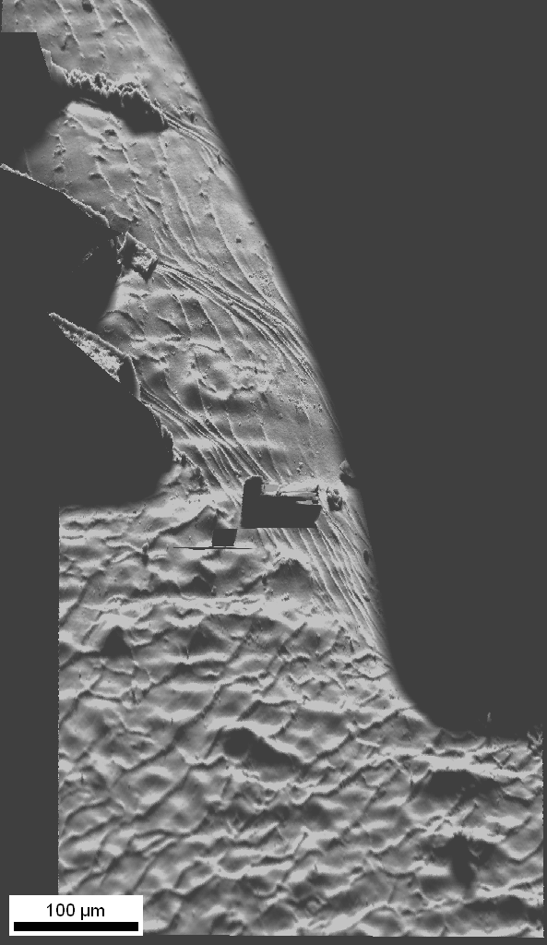
Microstructural evolution in adiabatic shear band
SE image of alpha alloy
Chip
Shear band
Grains undergo large deformation
Twinning is not observed.
Dislocation slip is dominant deformation mechanism.
Rigid body rotation of grains observed
Highly elongated
grains inside
shear band
Grain
deformation
In between
shear band
Free chip
surface
Tool
Shear
direction
Grain
rotation
Grain deformation
before formation
of shear band

Slide 18
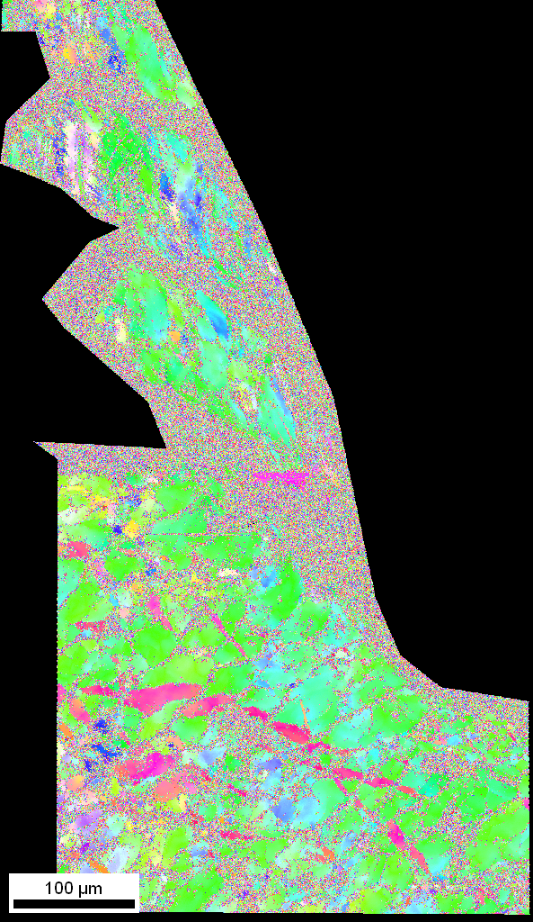
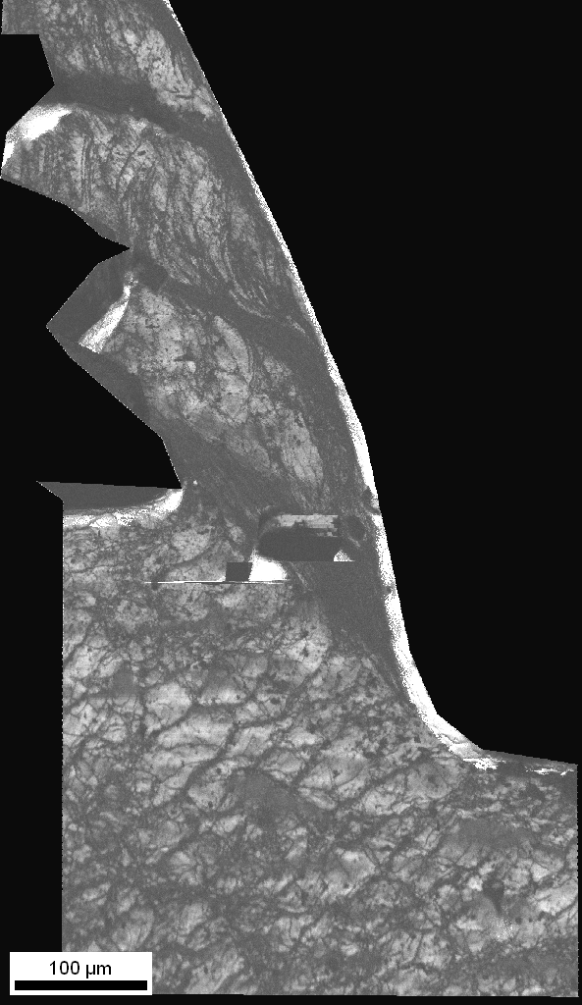
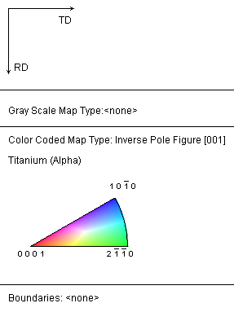
Microstructural evolution in adiabatic shear band
IPF
Image quality map
Chip
Chip
Region under
consideration
Shear
band
Shear
band
Tool
Shear direction
Shear zone
Shear zone
Work piece
Work piece

Slide 19
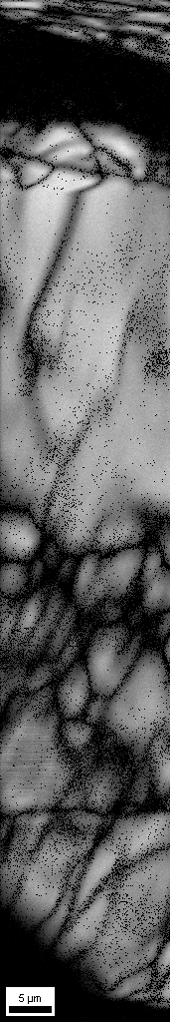



Microstructural changes in the shear band
SEM
image
Image
Quality
IPF
EBSD scan
step size 40 nm
Magnified image of shear band
Black region showing
deformed grains
Grain elongation
and subdivision
Shear band
region
Shear band
Chip segment
Regions surrounding the shear band shows
grains undergo subdivision and deformation
before the formation of shear band.
Shear
band

Slide 20
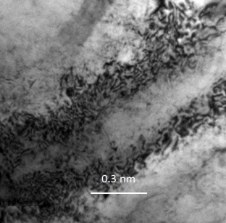
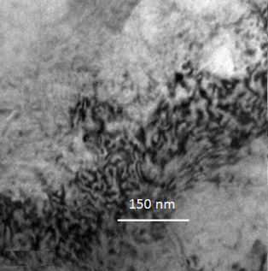
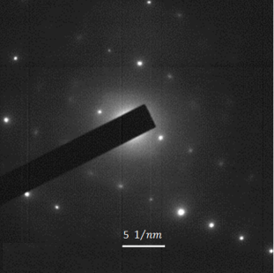
TEM study inside the shear band
Region outside
Shear band
Grains with
heavy dislocations
Edge of hole made by
twin jet polishing
Shear band
region
b.
Magnified
image
Deformed
grain
c.
SAD
a.
d.
Deformed grains inside the shear band and region of high dislocation density points against dynamic recrystallization

Slide 21
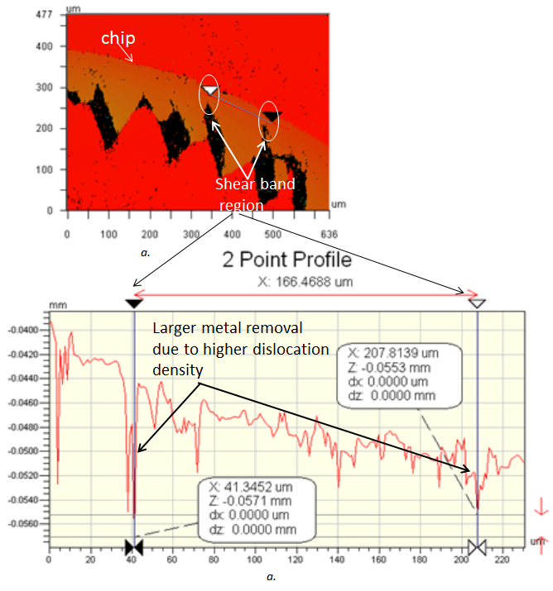
Observation of dislocation density by etch pit method
at shear band region
Polished chip is etched for 10 minute.
A valley formed at the shear band region shows higher material removal from that region.
This indicates shear band region is a strained one with high dislocation density

Slide 22
Comparison of observations with previous TEM studies
 | Experiments in this work | Meyer and Pak (1995,2001,2003) | Perez-prado, Acta mater. Acta mater. 49 (2001) 2905–2917
Observations | No dynamic recrystallized grains are observed in EBSD scan and TEM TEM reveals grains with high dislocation densities in the shear band. Grains surrounding shear band are highly elongated and have shown sub-grain formation | Equi-axed grains with dia. 0.05-0.2 µm. Low dislocation density. Inside shear band, a ring like pattern produced by many crystallographic orientation is apparent. Diahedral angle (~120)at grain boundary triple point indicate that the boundaries have energies consistent with high angles | Cell size 0.2 µm, New dislocation free grains was not observed in TEM, Only dynamic recovery occurred. Appearance of ring like pattern in the center of shear band is not enough evidence for recrystallization. Recrystallization is not observed
Conclusions | No DRX | DRX | No DRX

